Slide 1
Interface learning for model fusion
Shady Ahmed¹, Suraj Pawar¹, Omer San¹
In collaboration with: Kursat Kara¹, Rami Younis², Adil Rasheed³
¹Oklahoma State University, ²The University of Tulsa, ³Norwegian University of Science and Technology

Slide 2
Motivation
There are different methods in computational science
Each of these methods can provide solution of different level of accuracy and involves different computational resources.
Goal: To employ different solvers in different regions of the computational domain to exploit computational resources effectively.

Slide 3
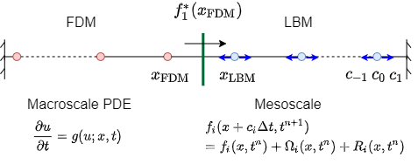
Interface learning for model fusion

Slide 4



FitzHugh-Nagumo model

Slide 5
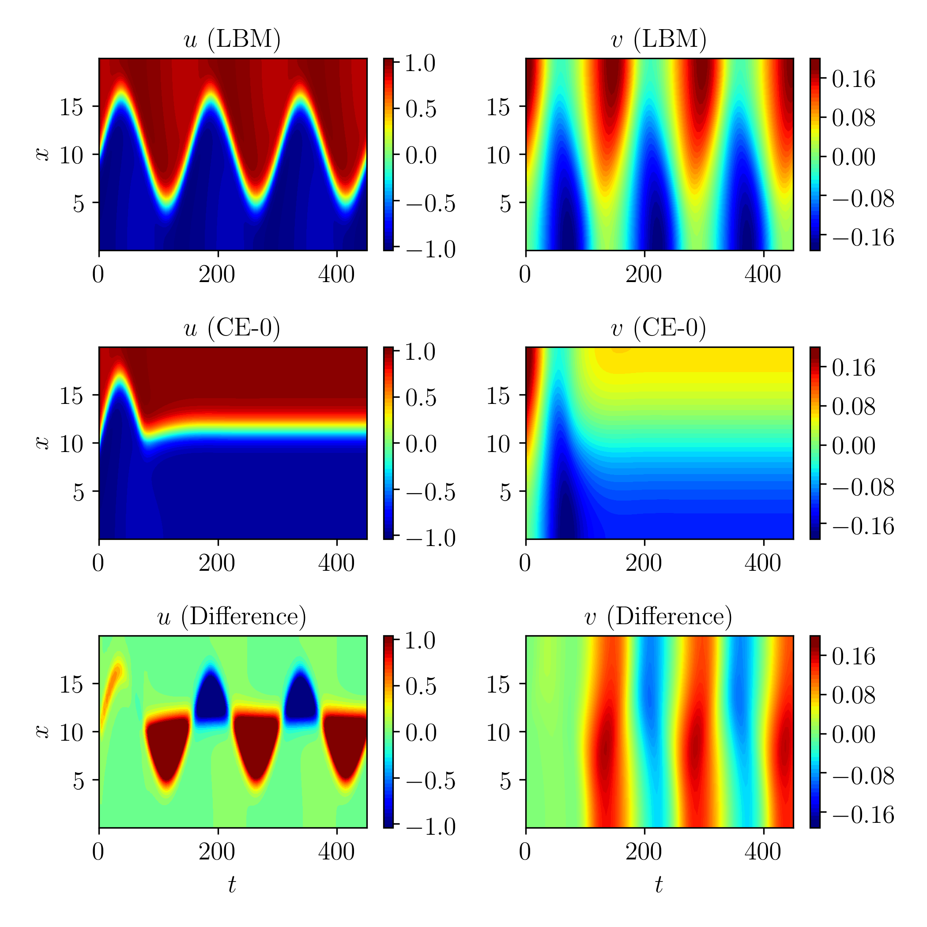

FitzHugh-Nagumo model
CE-0: Simplest approximation

Slide 6
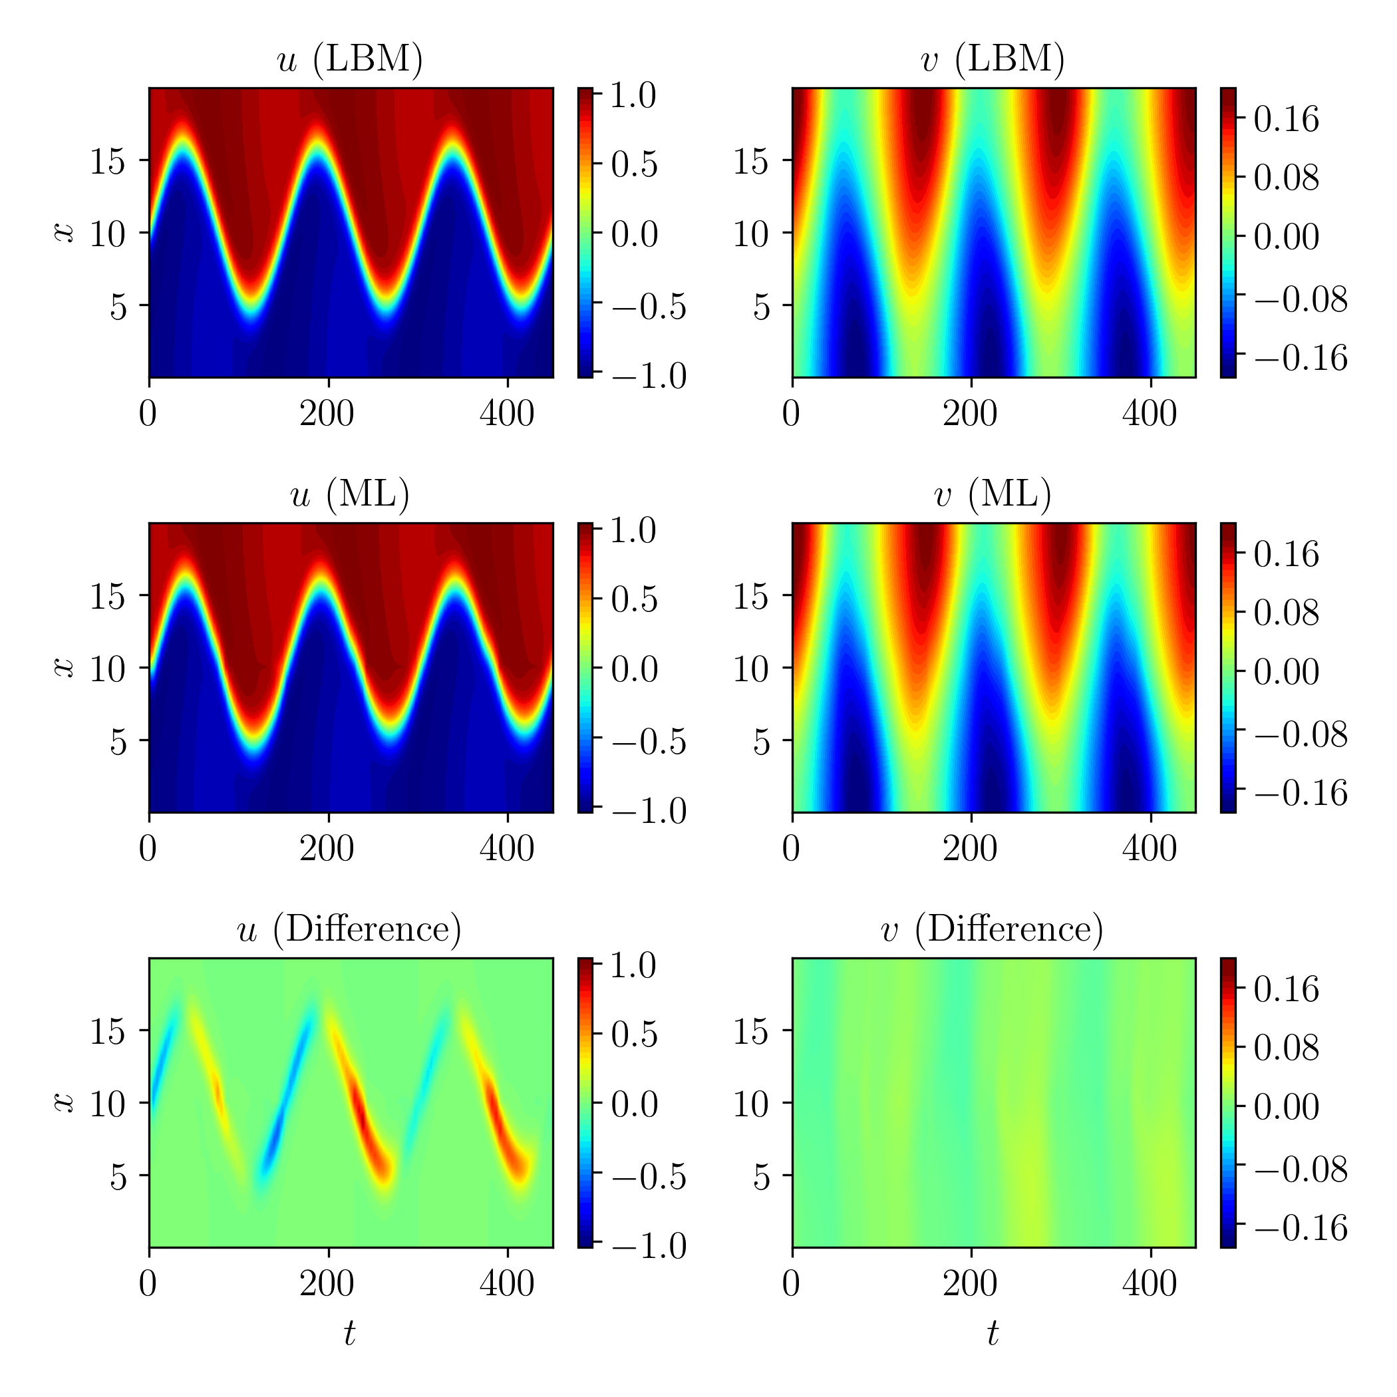

FitzHugh-Nagumo model
ML: Statistical learning
Simple feedforward neural network with single hidden layer and 8 neurons

Slide 7



FitzHugh-Nagumo model
CE-1: First-order approximation

Slide 8


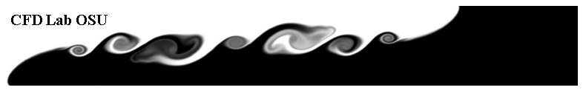

Thanks!
Ref: “Interface learning in fluid dynamics: Statistical inference of closures within micro–macro-coupling models”, Physics of Fluids, 2020
CFD Lab OSU
Computational Fluid Dynamics Laboratory
www.cfdlab.org

